Slide 1

GEOG0113 Lecture 004 Photosynthesis
P. Lewis
UCL Geography
& NERC NCEO

Slide 2
Aims of lecture
In this lecture, we will:
look in some detail at photosynthesis and factors that limit this

Slide 3
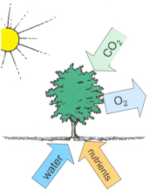
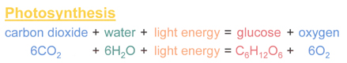
Photosynthesis
Notes:
In essence, what it does is to split (proportionately) 12 water molecules (H20) and produce 6 molecules of oxygen gas (O2) and 6 of H20. Carbon dioxide is reduced to glucose (C6H12O6) which is the basic material from which other biochemical constituents of biomass are synthesised (Grace, 2001). Note that the additional 6H2O are omitted in the figure above which does not include transpiration.

Slide 4
Transpiration
Provides 10% of moisture found in atmosphere.
uses around 90% of water that enters plant
(the rest being used in cell growth and photosynthesis).
Most transpiration water in stomata of the leaves.
guard cells of the stomata open to allow CO2 diffusion from the air for photosynthesis.
can be thought of as the “cost” for opening stomata to allow the diffusion of carbon dioxide gas from the air.

Slide 5
Stomatal conductance
Stomatal conductance, (e.g. in mmol m⁻² s⁻²)
measure of the rate of passage of carbon dioxide (CO2) exiting, or water vapor entering through the stomata of a leaf.
controlled by guard cells leaf stomata and controls transpiration rates and CO2 diffusion rates (along with gradients of water vapour and CO2).

Slide 6
Transpiration serves three main roles:
movement of minerals
(from roots: xylem) and sugars (from photosynthesis: phloem) throughout the plant.
cooling
(loss of heat energy through transpiration)
maintenance of turgor pressure
in plant cells for plant structure and the functioning of guard cells in the stomata to regulate water loss and CO2 uptake.

Slide 7
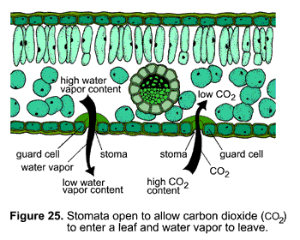
stomata

Slide 8
three types of photosynthesis mechanisms
C3, C4, CAM (Crassulacean acid metabolism)
C3 (much older, but less efficient)
85% of plants
wheat, barley, potatoes and sugar beet and most trees.
cannot grow in hot climates because RuBisCO incorporates more oxygen into RuBP as temperatures increase
photorespiration and a net loss of carbon (and nitrogen) that can act as a limit to growth.
C3 plants are also sensitive to water availability.
Notes:
Rubisco Ribulose-1,5-bisphosphate carboxylase/oxygenase

Slide 9
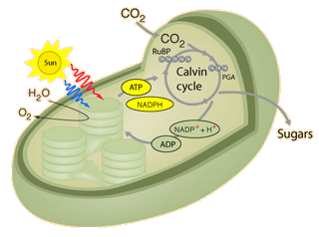
C3 plants use the Calvin cycle for fixing CO2.
Notes:
In the first step of the cycle CO2 reacts with RuBP to produce two 3-carbon molecules of 3-phosphoglyceric acid (3-PGA). This is the origin of the designation C3 or C3 in the literature for the cycle and for the plants that use this cycle. The entire process, from light energy capture to sugar production occurs within the chloroplast. The light energy is captured by the non-cyclic electron transport process which uses the thylakoid membranes for the required electron transport.

Slide 10
C4 Plants
C4 plants (and CAM plants)
more efficient than C3 plants under conditions of drought, high temperatures, and nitrogen or CO2 limitation.
bypassing the photorespiration pathway and efficiently delivering CO2 to the RuBisCO enzyme

Slide 11
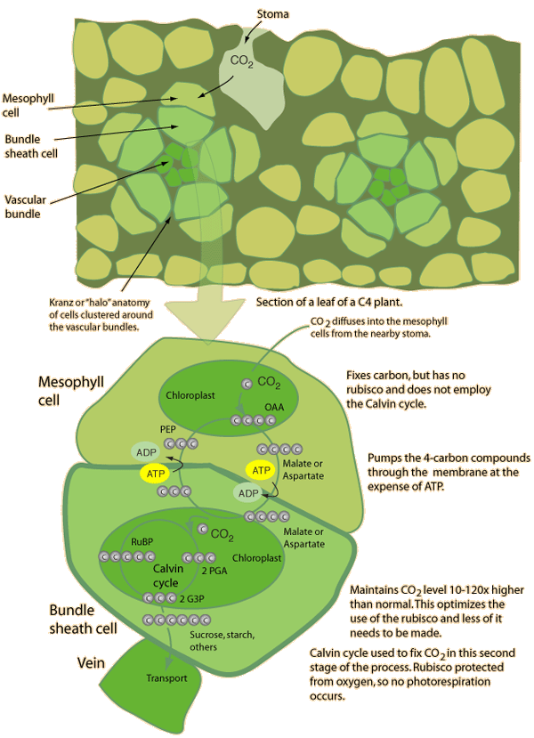
C4
Notes:
Different structure

Slide 12
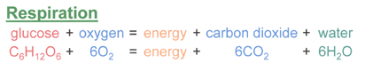
Respiration
(autotrophic) respiration
plants convert sugars back into CO2 and water, and release energy in the process.
energy released used for growth and maintenance of existing material.
Consumes 25% to75% of all of the carbohydrates generated in photosynthesis.

Slide 13
Limitations to photosynthesis at the leaf level
light limitation;
CO2 limitation;
nitrogen limitation and photosynthetic capacity;
water limitation;
temperature effects;
pollutants

Slide 14
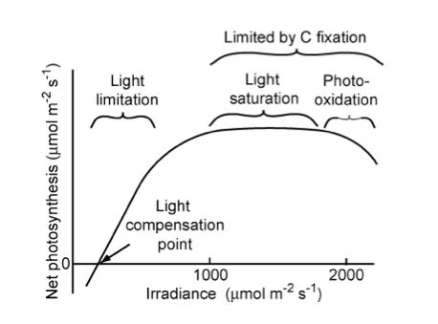
light limitation
Notes:
"Relationship of net photosynthetic rate to photosynthetically active radiation and the processes that limit photosynthesis at different irradiances. The linear increase in photosynthesis in response to increased light (in the range of light limitation) indicates relatively constant light use efficiency. The light compensation point is the minimum irradiance at which the leaf shows a net gain of carbon. " Source: Chapin, 2011, PTEEChap5.ppt, fig. 5.5

Slide 15
Light limitation
rate of change of net photosynthesis in low-moderate region: quantum yield of photosynthesis.
Similar for all C3 (non stress) at ~6%
Saturation at higher levels: reduced efficiency
Acclimation responses
Sun leaves
More cell layers and higher photosynthetic capacity
Respiration rate depends on tissue protein content
So shade leaves lower protein content to minimise respiration losses

Slide 16
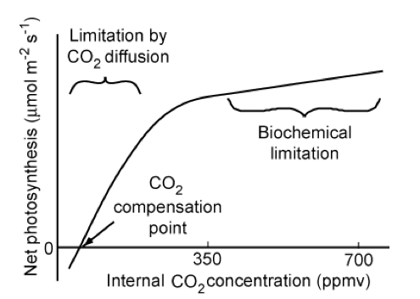
CO2 limitation
C3
Notes:
"Relationship of the net photosynthetic rate to the CO2 concentration inside the leaf. Photosynthetic rate is limited by the rate of CO2 diffusion into the chloroplast in the initial (left-hand side) linear portion of the CO2 response curve and by biochemical processes at higher CO2 concentrations. The CO2 compensation point is the minimum CO2 concentration at which the leaf shows a net gain of carbon. " Source: Chapin, 2011, PTEEChap5.ppt, fig. 5.10

Slide 17
CO2 limitation
Over long term, indirect effects of elevated CO2 concentrations may be more important than increased net photosynthesis rates
E.g. changes to water cycle
C4 relatively unresponsive
Less competitive in higher CO2 environment?
Probably indirect effects important

Slide 18
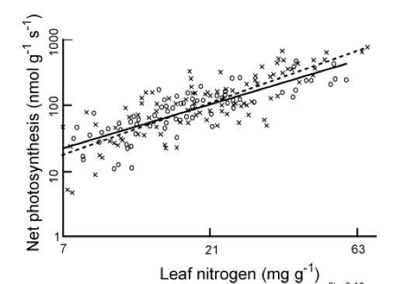
Nitrogen limitation and photosynthetic capacity
Reich et al 1997: 11 species, 6 biomes
Notes:
"Relationship between leaf nitrogen concentration and maximum photosynthetic capacity (photosynthetic rate measured under favorable conditions) for plants from Earth's major biomes. Circles and the solid regression line are for 11 species from six biomes using a common methodology. Crosses and the dashed regression line are data from the literature. Redrawn from Reich et al. (1997)." Source: Chapin, 2011, PTEEChap5.ppt, fig. 5.11

Slide 19
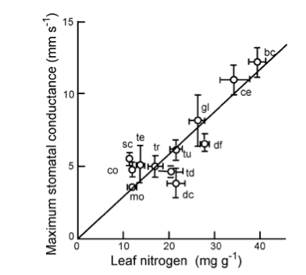
Nitrogen
bc: Broadleaf crops
ce: cereal crops
co: evergreen conifer
dc: deciduous conifer
df: tropical dry forest
gl: grassland
mo: monsoonal forest
sc: sclerophyllous shrub
sd; dry savanna
sw: wet savanna
tc: tropical tree crop
td: temeperate decid broadleaf
te: temp everg broadleaf
tr: tropical wet forest
tu: tundra
Notes:
"Relationship between leaf nitrogen concentration and maximum stomatal conductance of plants from Earth's major biomes. Each point and its standard error represent a different biome: bc, broad-leafed crops; ce, cereal crops; co, evergreen conifer forest; dc, deciduous conifer forest; df, tropical dry forest; gl, grassland; mo, monsoonal forest; sc, sclerophyllous shrub; sd, dry savanna; sw, wet savanna; tc, tropical tree crop; td, temperate deciduous broadleaved forest; te, temperate evergreen broadleaved forest; tr, tropical wet forest; tu, herbaceous tundra. Redrawn from Schulze et al. (1994)." Source: Chapin, 2011, PTEEChap5.ppt, fig. 5.12

Slide 20
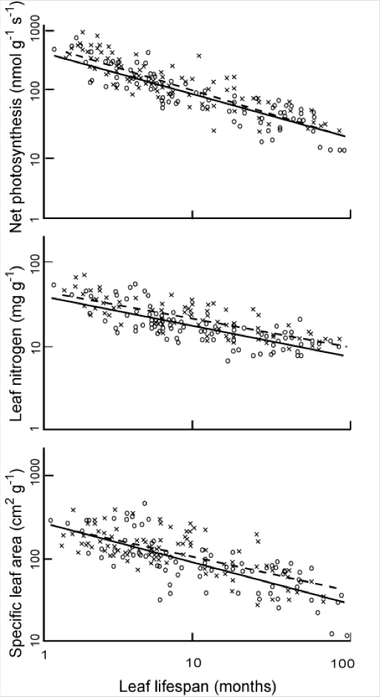
Nitrogen
Relationships between N, leaf lifespan, SLA and net photosynthesis
higher the leaf N concentration, the shorter the leaf lifespan.
Leaves with shorter lifespans tend to have lower specific leaf area (SLA, the leaf surface area per unit of biomass) (i.e. long-lived leaves are more dense), so higher leaf N concentration correlates with higher SLA.
Notes:
"The effect of leaf lifespan on photosynthetic capacity, leaf nitrogen concentration, and specific leaf area. Symbols as in Fig. 5.13. Redrawn from Reich et al. (1997)" Source: Chapin, 2011, PTEEChap5.ppt, fig. 5.13

Slide 21
Water limitation
reduces the capacity of leaves to match CO2 supply with light availability
manifested as a decrease in leaf relative water content (RWC).
Decreasing RWC progressively decreases stomatal conductance which slows CO2 assimilation (lower photosynthetic capacity) although different studies show different responses for RWC between 100% and 70%

Slide 22
Water limitation
Plants acclimated and adapted to dry conditions
reduce photosynthetic capacity and leaf N concentrations
low stomatal conductance that conserves water
minimse leaf area (shedding or lower leaf production rates) to minimise water loss.
Some minimise radiation absorption by higher leaf reflectance more vertically-inclined (erectophile) leaves.

Slide 23
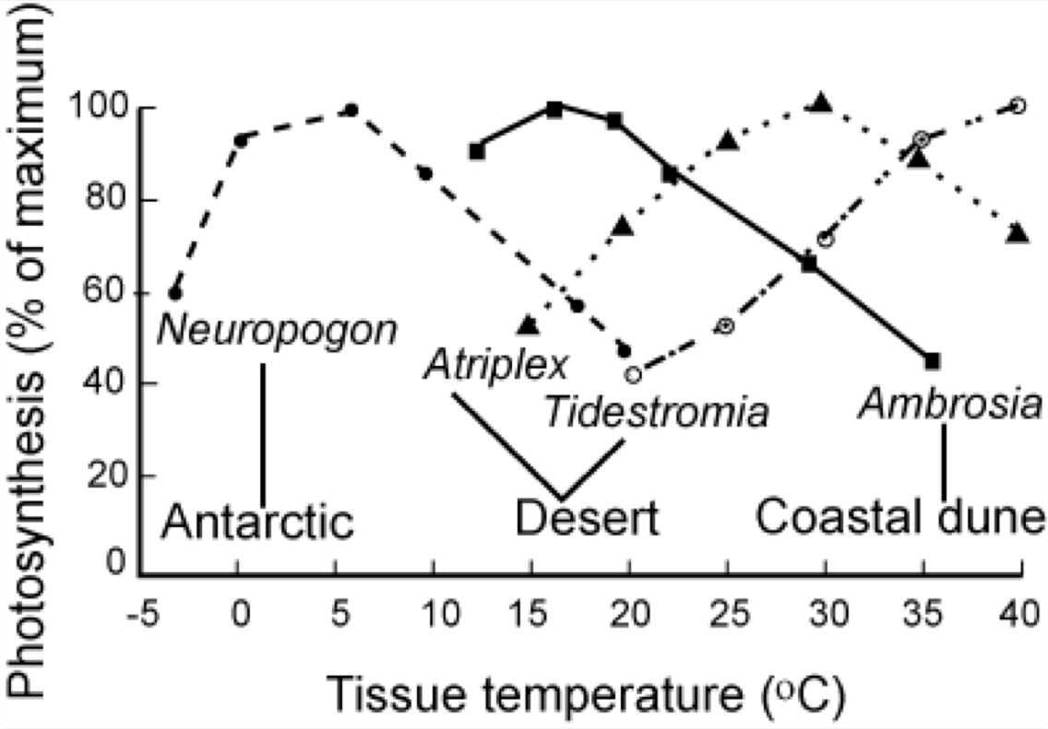
Temperature effects
Notes:
Adaptation for different species, but all have optimal operating range

Slide 24
summary
looked in some detail at photosynthesis and factors that limit this
C3/C4 plants
Limiting factors and roles

Slide 25
READING
Allen, R.G et al., 1998, Crop evapotranspiration - Guidelines for computing crop water requirements - FAO Irrigation and drainage paper 56 for a good practical guide to Agrometeorology, and a wider range of agricultural (and societal) documents in the FAO Corporate Document Repository.
Grace, J., (2001) Carbon Cycle, in Encyclopedia of Biodiversity, Vol. 1, Academic Press
Stevens, A. (2011) Introduction to the Basic Drivers of Climate. Nature Education Knowledge 2(2):6
Forseth, I. (2010) Terrestrial Biomes. Nature Education Knowledge 1(8):12
Stevens, A. N. (2011) Factors Affecting Global Climate. Nature Education Knowledge 2(1):5
Gough, C. M. (2011) Terrestrial Primary Production: Fuel for Life. Nature Education Knowledge 2(2):1
Lawlor, D.W. (2002) Limitation to Photosynthesis in Water-stressed Leaves: Stomata vs. Metabolism and the Role of ATP, Ann Bot (2002) 89 (7): 871-885. doi: 10.1093/aob/mcf110

